Slide 1


The role of hydrogen bonding in forming secondary structure in a proposed DNA precursor
Kevin Gochenour
Northern Arizona University
Lindberg Research Group

Slide 2
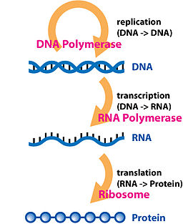

How did life spontaneously occur on Earth?
Image from Don Dixon 2016.
Image from Wikipedia 2017.
Notes:
Talking points:
1. Each header in red represents an enzyme (catalyst) which allows this process to occur spontaneously. Which begs the question if we need enzymes to form DNA and RNA and DNA and RNA is needed to build enzymes then what made the first enzyme which produced the first strand of RNA or DNA?
2. There are many competing theories for how we go from the building blocks of life dissolved in the oceans on early Earth to the modern condition we see here, but all proposed so far still do not begin spontaneously.

Slide 3
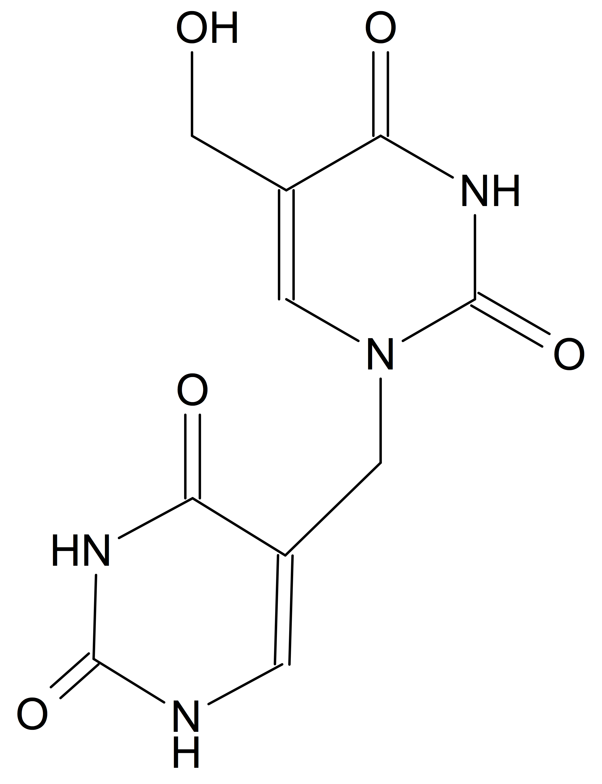
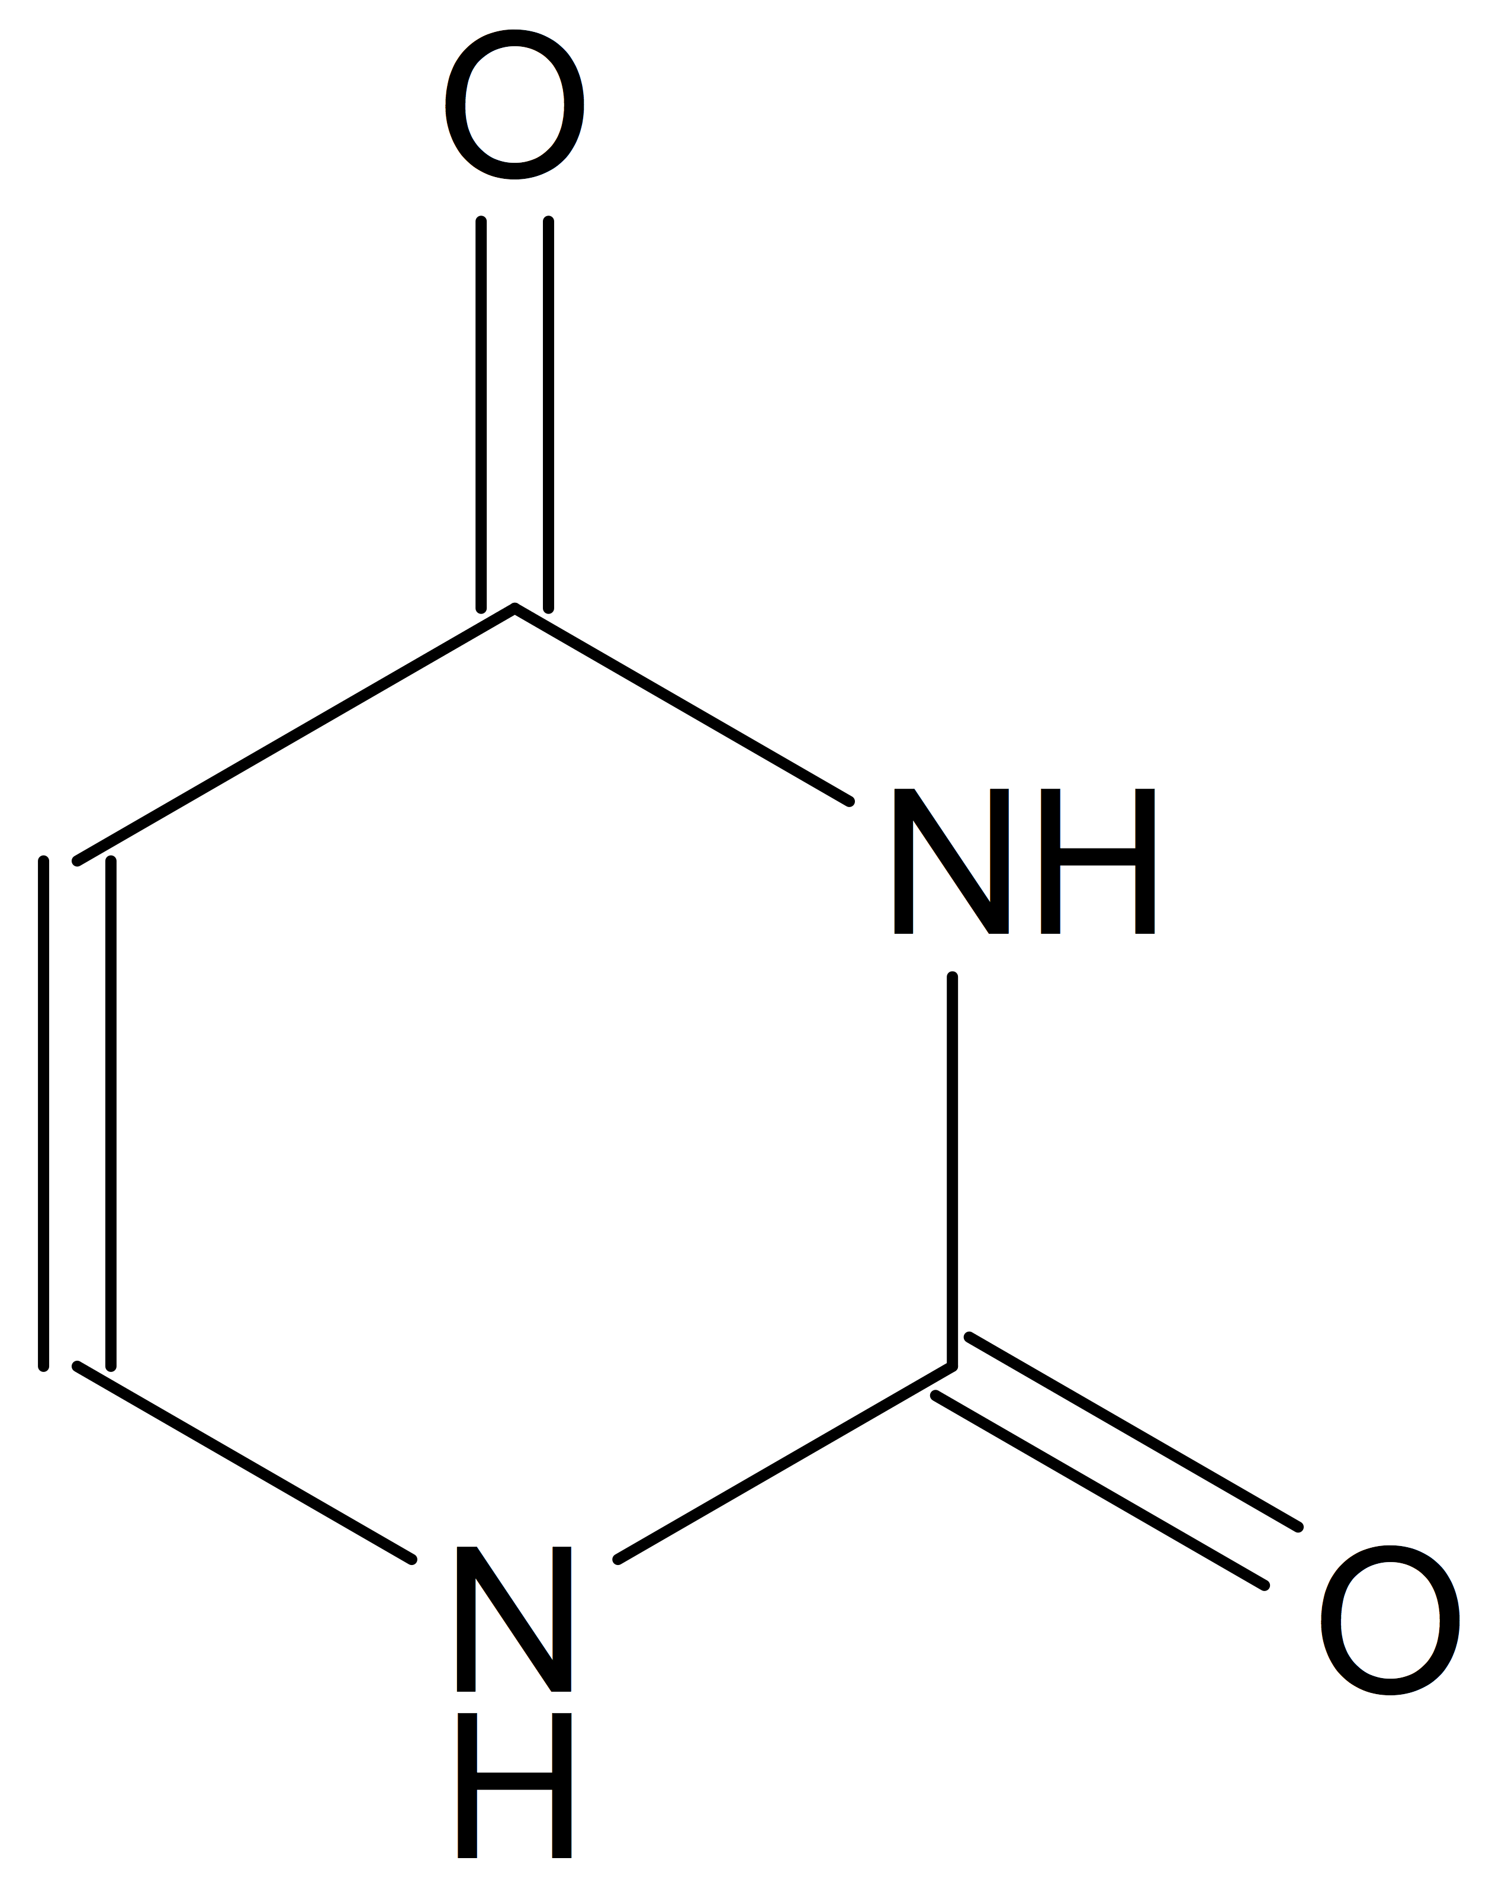
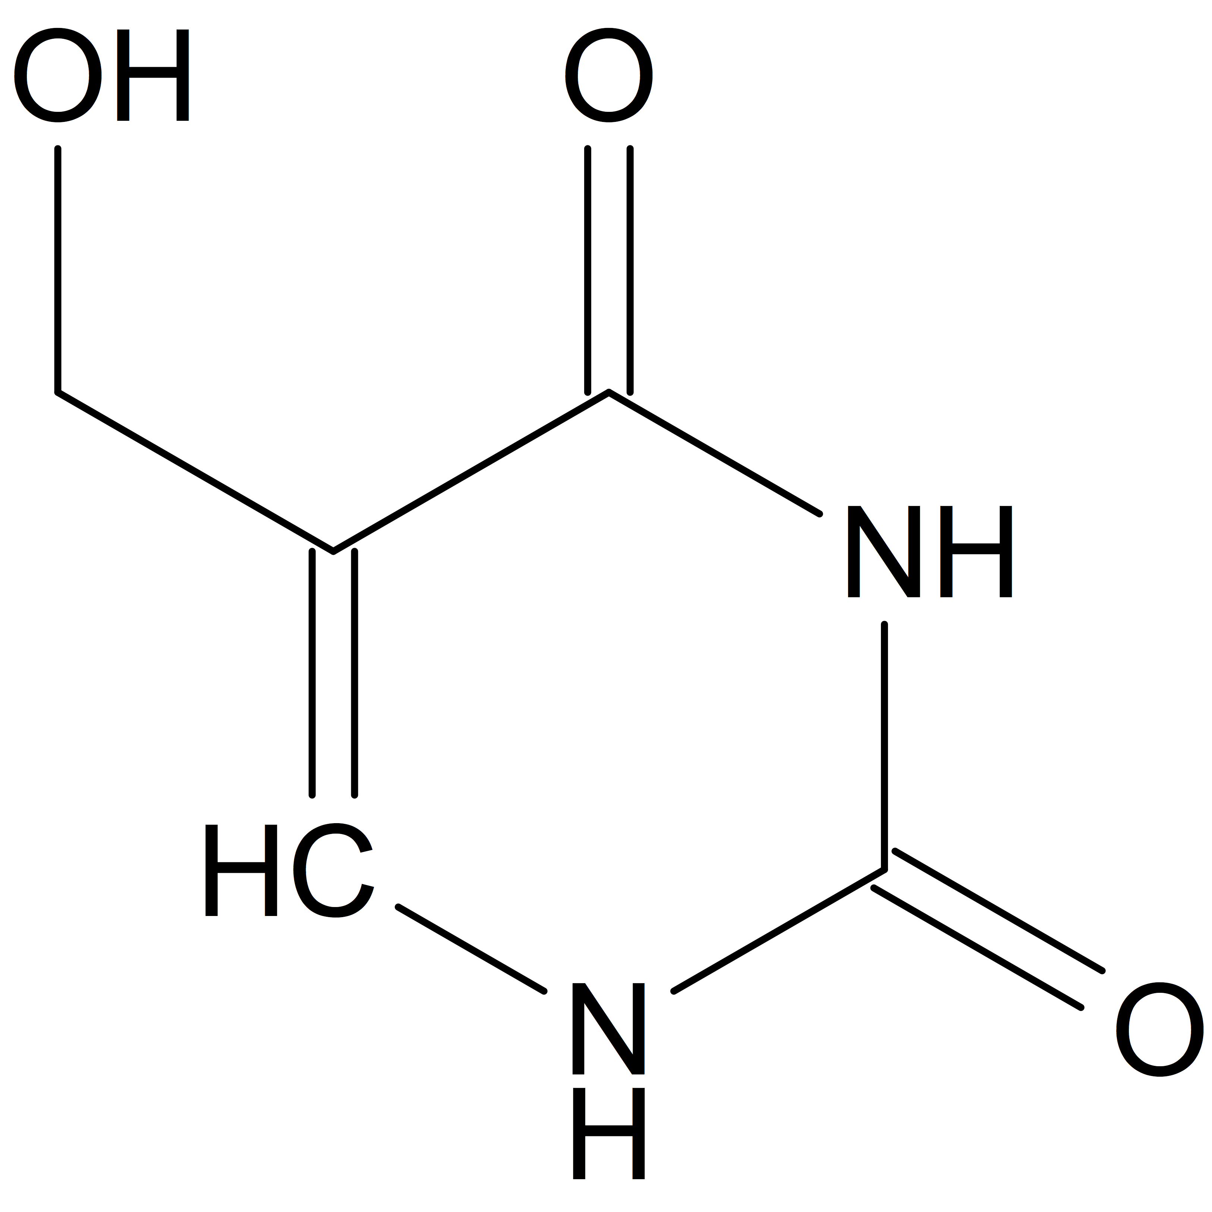
A spontaneously forming proposed genetic precursor
HMU Oligomer
Uracil
5 – Hydroxymethyl Uracil (HMU)
Callahan, M., et al. Proc Natl Acad Sci USA. 2011, 108, 13995 – 13998.
Smith, K., et al. Orig Life Evol Biosph. 2016, 47, 3 – 11.
Notes:
Talking point:
Prior work has shown that HMU & HMC can form spontaneously (no catalyst) from uracil & cytosine, and recent work shows HMU / HMC can spontaneously (no catalyst) form chains called oligomers.
Do these oligomers have biological function? i.e. Can they store genetic information and / or catalyze reactions?

Slide 4
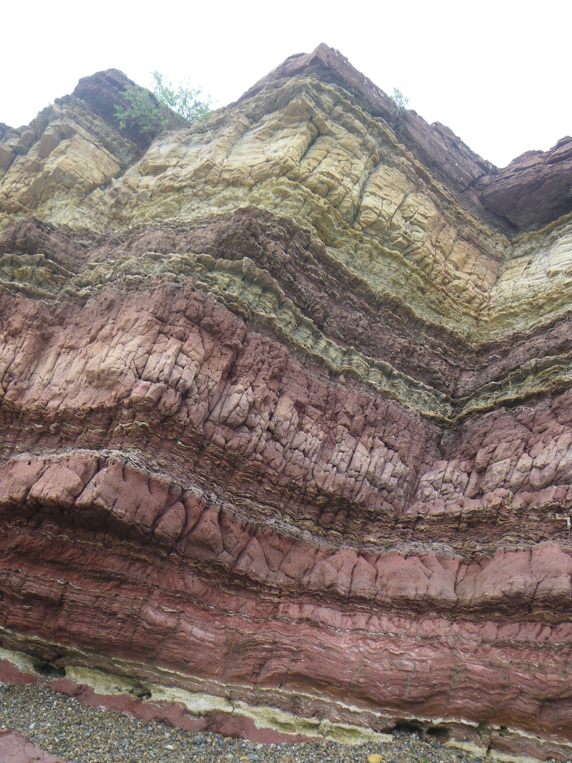
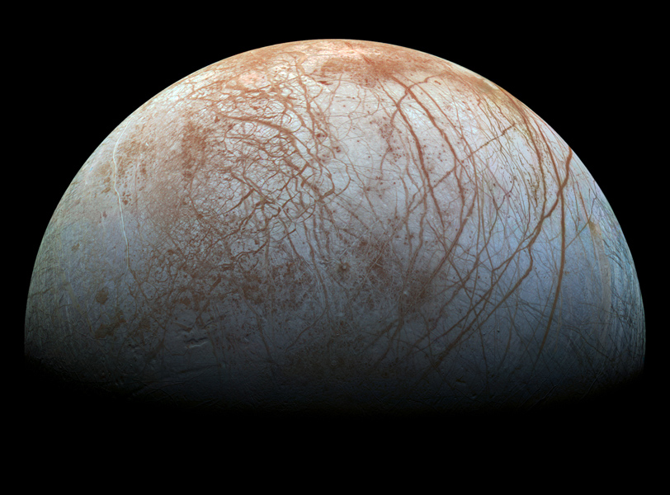
How do we investigate biological function?
?
Image from Michael Gibson Archeology
Image from www.jpl.nasa.gov 2014.
Molecular Dynamics Simulation
Notes:
Talking points:
We can time travel and search for evidence in the geologic record, but these biomolecules are not well preserved in the rock record.
We can travel to other locations in the solar system where these processes may be occurring now, but this is expensive and success is not guaranteed.
We can use Molecular Dynamics Simulation to perform theoretical investigations of proposed precursor molecules.

Slide 5
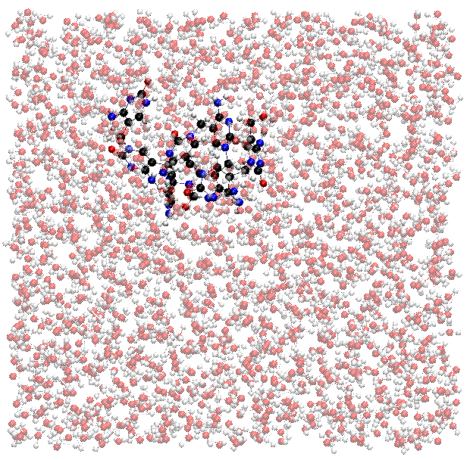
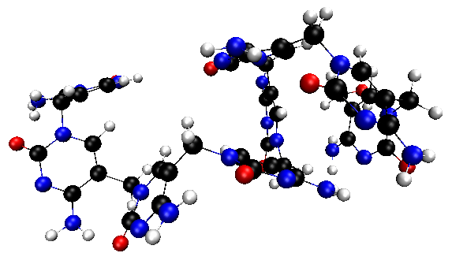
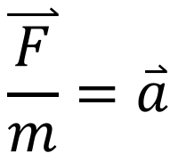
$$\overset{⃑}{\frac{F}{m}}=\overset{⃑}{a}$$
Notes:
Talking points:
Molecular dynamics is essentially making a movie, we start with a box filled with the molecule of interest and in this case we fill the remaining space with water.
To simplify this demonstration lets remove the water and zoom in on the molecule of interest, if we apply Newton’s 2nd Law to each atom within this molecule we can predict the position of each atom 1 frame of the movie into the future.
Mass is easily calculated, the force is derived from the potential energy contributions of many factors of molecular motion and interactions for each atom.

Slide 6
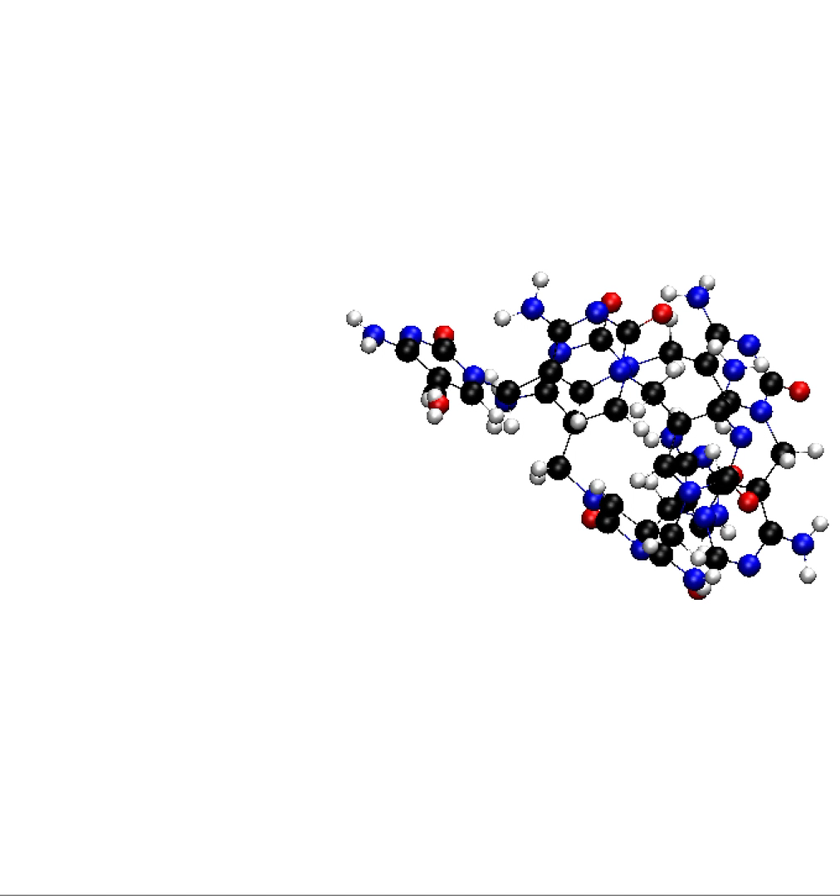

$$\overset{⃑}{\frac{F}{m}}=\overset{⃑}{a}$$
Notes:
Talking points:
1. By observing how the atoms move over time we can make calculations and predictions about the structure and function of the molecule.

Slide 7
Is there an association between Hydrogen Bonding & Radius of Gyration?
Hydrogen Bonding
Radius of Gyration
Sphere
R_{gyr}
Hydrogen Bonds
Notes:
Talking points:
Hydrogen bonds are very important to forming secondary structure in proteins and DNA / RNA giving them useful biological functionality.
Radius of gyration is a measure of a molecule’s compactness, the more compact a molecule is the more likely biologically useful structure is present.
If there is an association between higher numbers of hydrogen bonds and a more compact structure we would have reason to believe useful biological structure could occur.

Slide 8
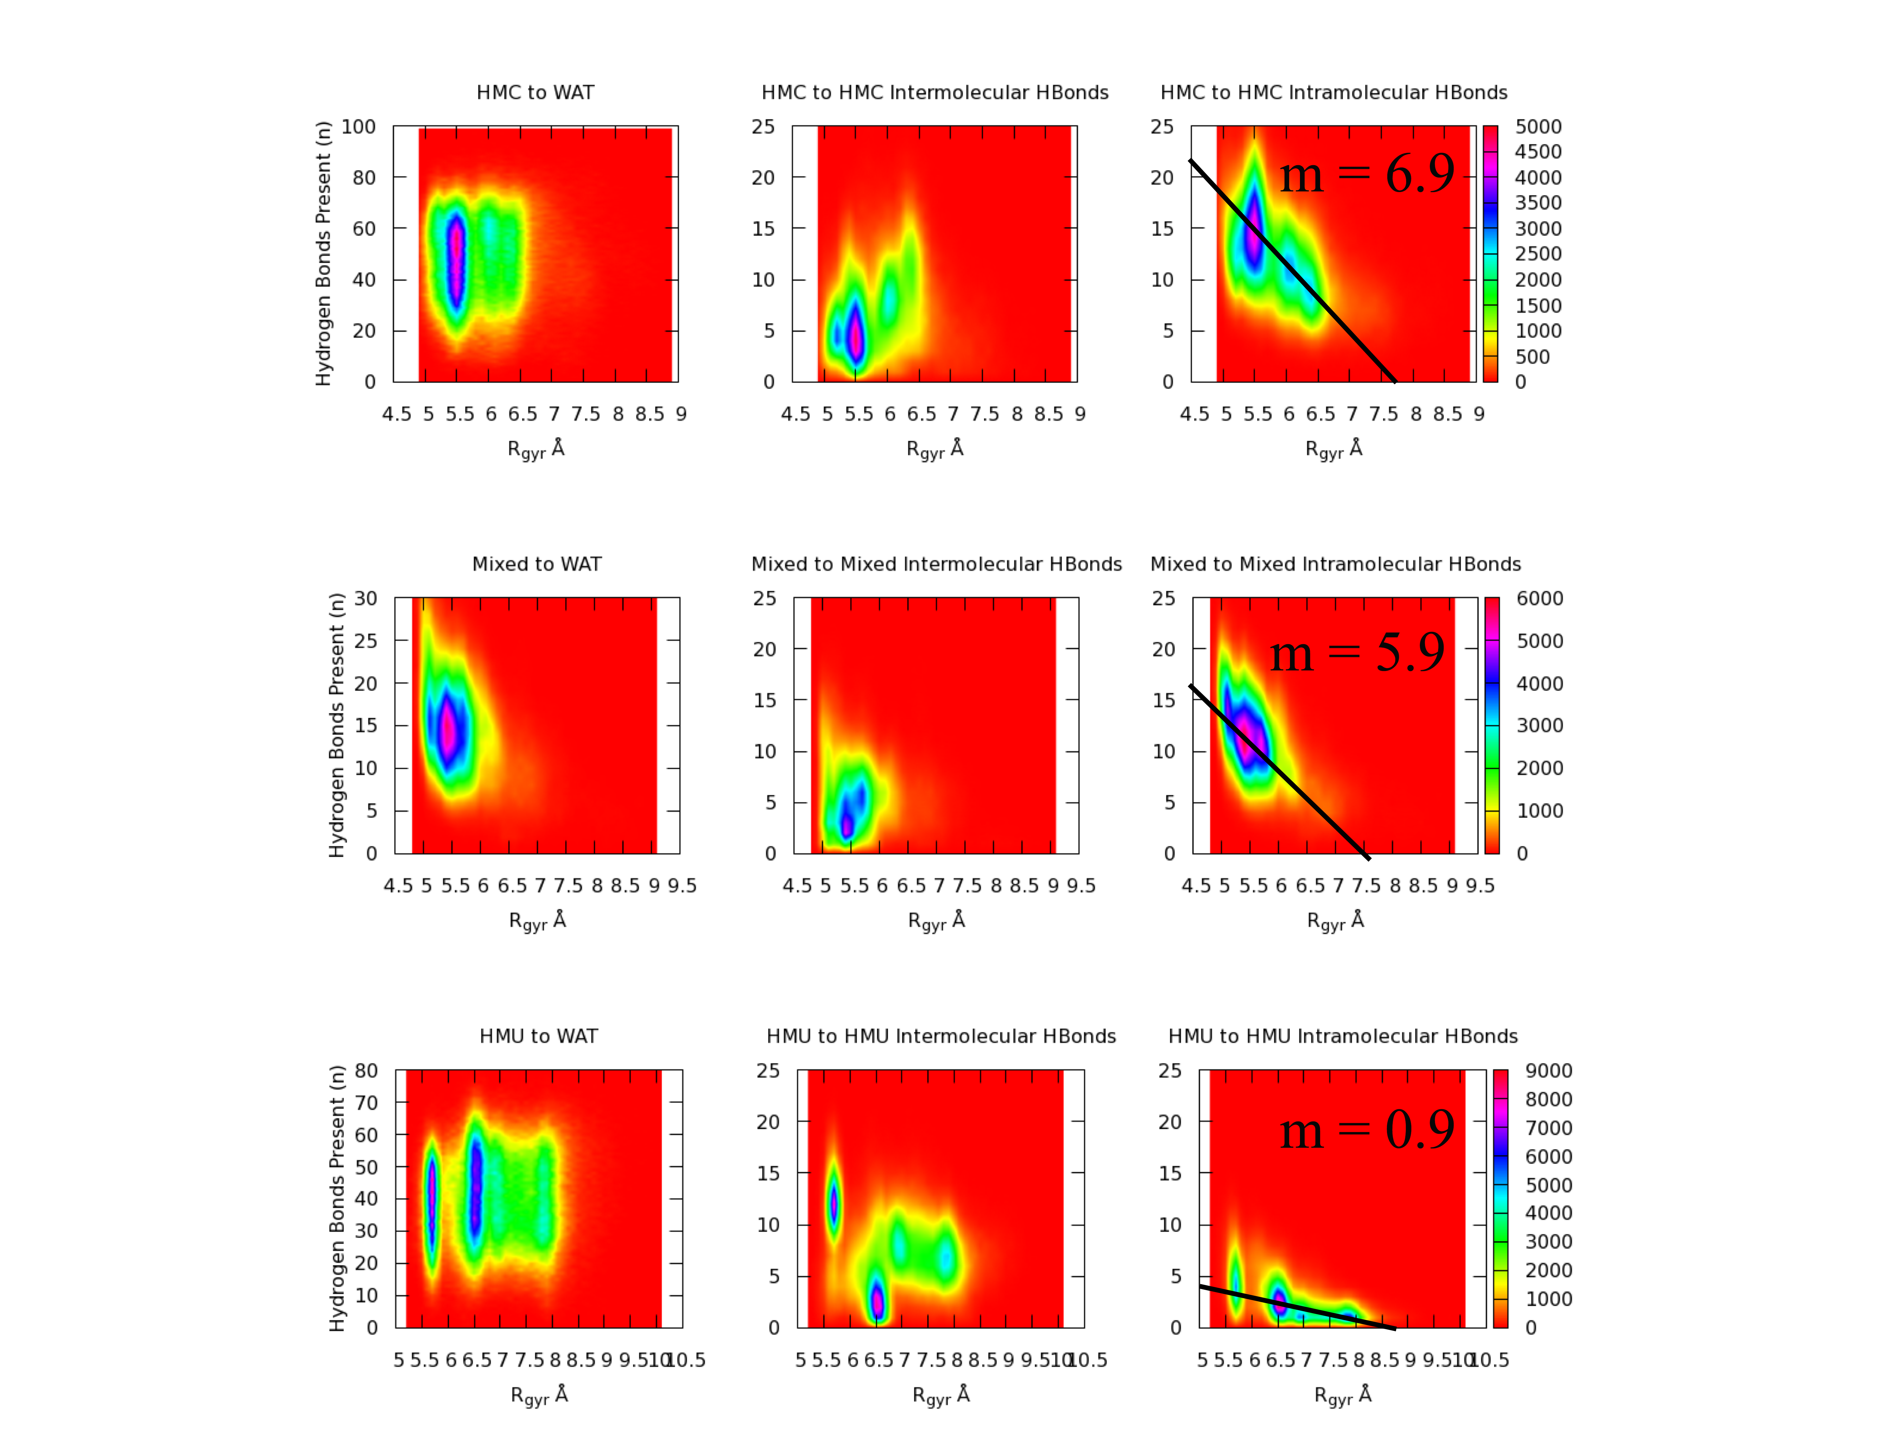
Results
Increasing Compactness
Notes:
Talking Points:
No association observed between hydrogen bonds with water and increased compactness, important because it suggests something other than the hydrophobic effect (poplar and nonpolar molecules avoiding each other) is affecting structure.
Decreasing association observed between intermolecular hydrogen bonds and increased compactness, important because it suggests something other than phase separation is affecting structure.
Increasing association observed between intramolecular hydrogen bonds and increased compactness, important because this is similar to higher order structure observed in proteins and DNA / RNA which gives them their biogical functionality.

Slide 9
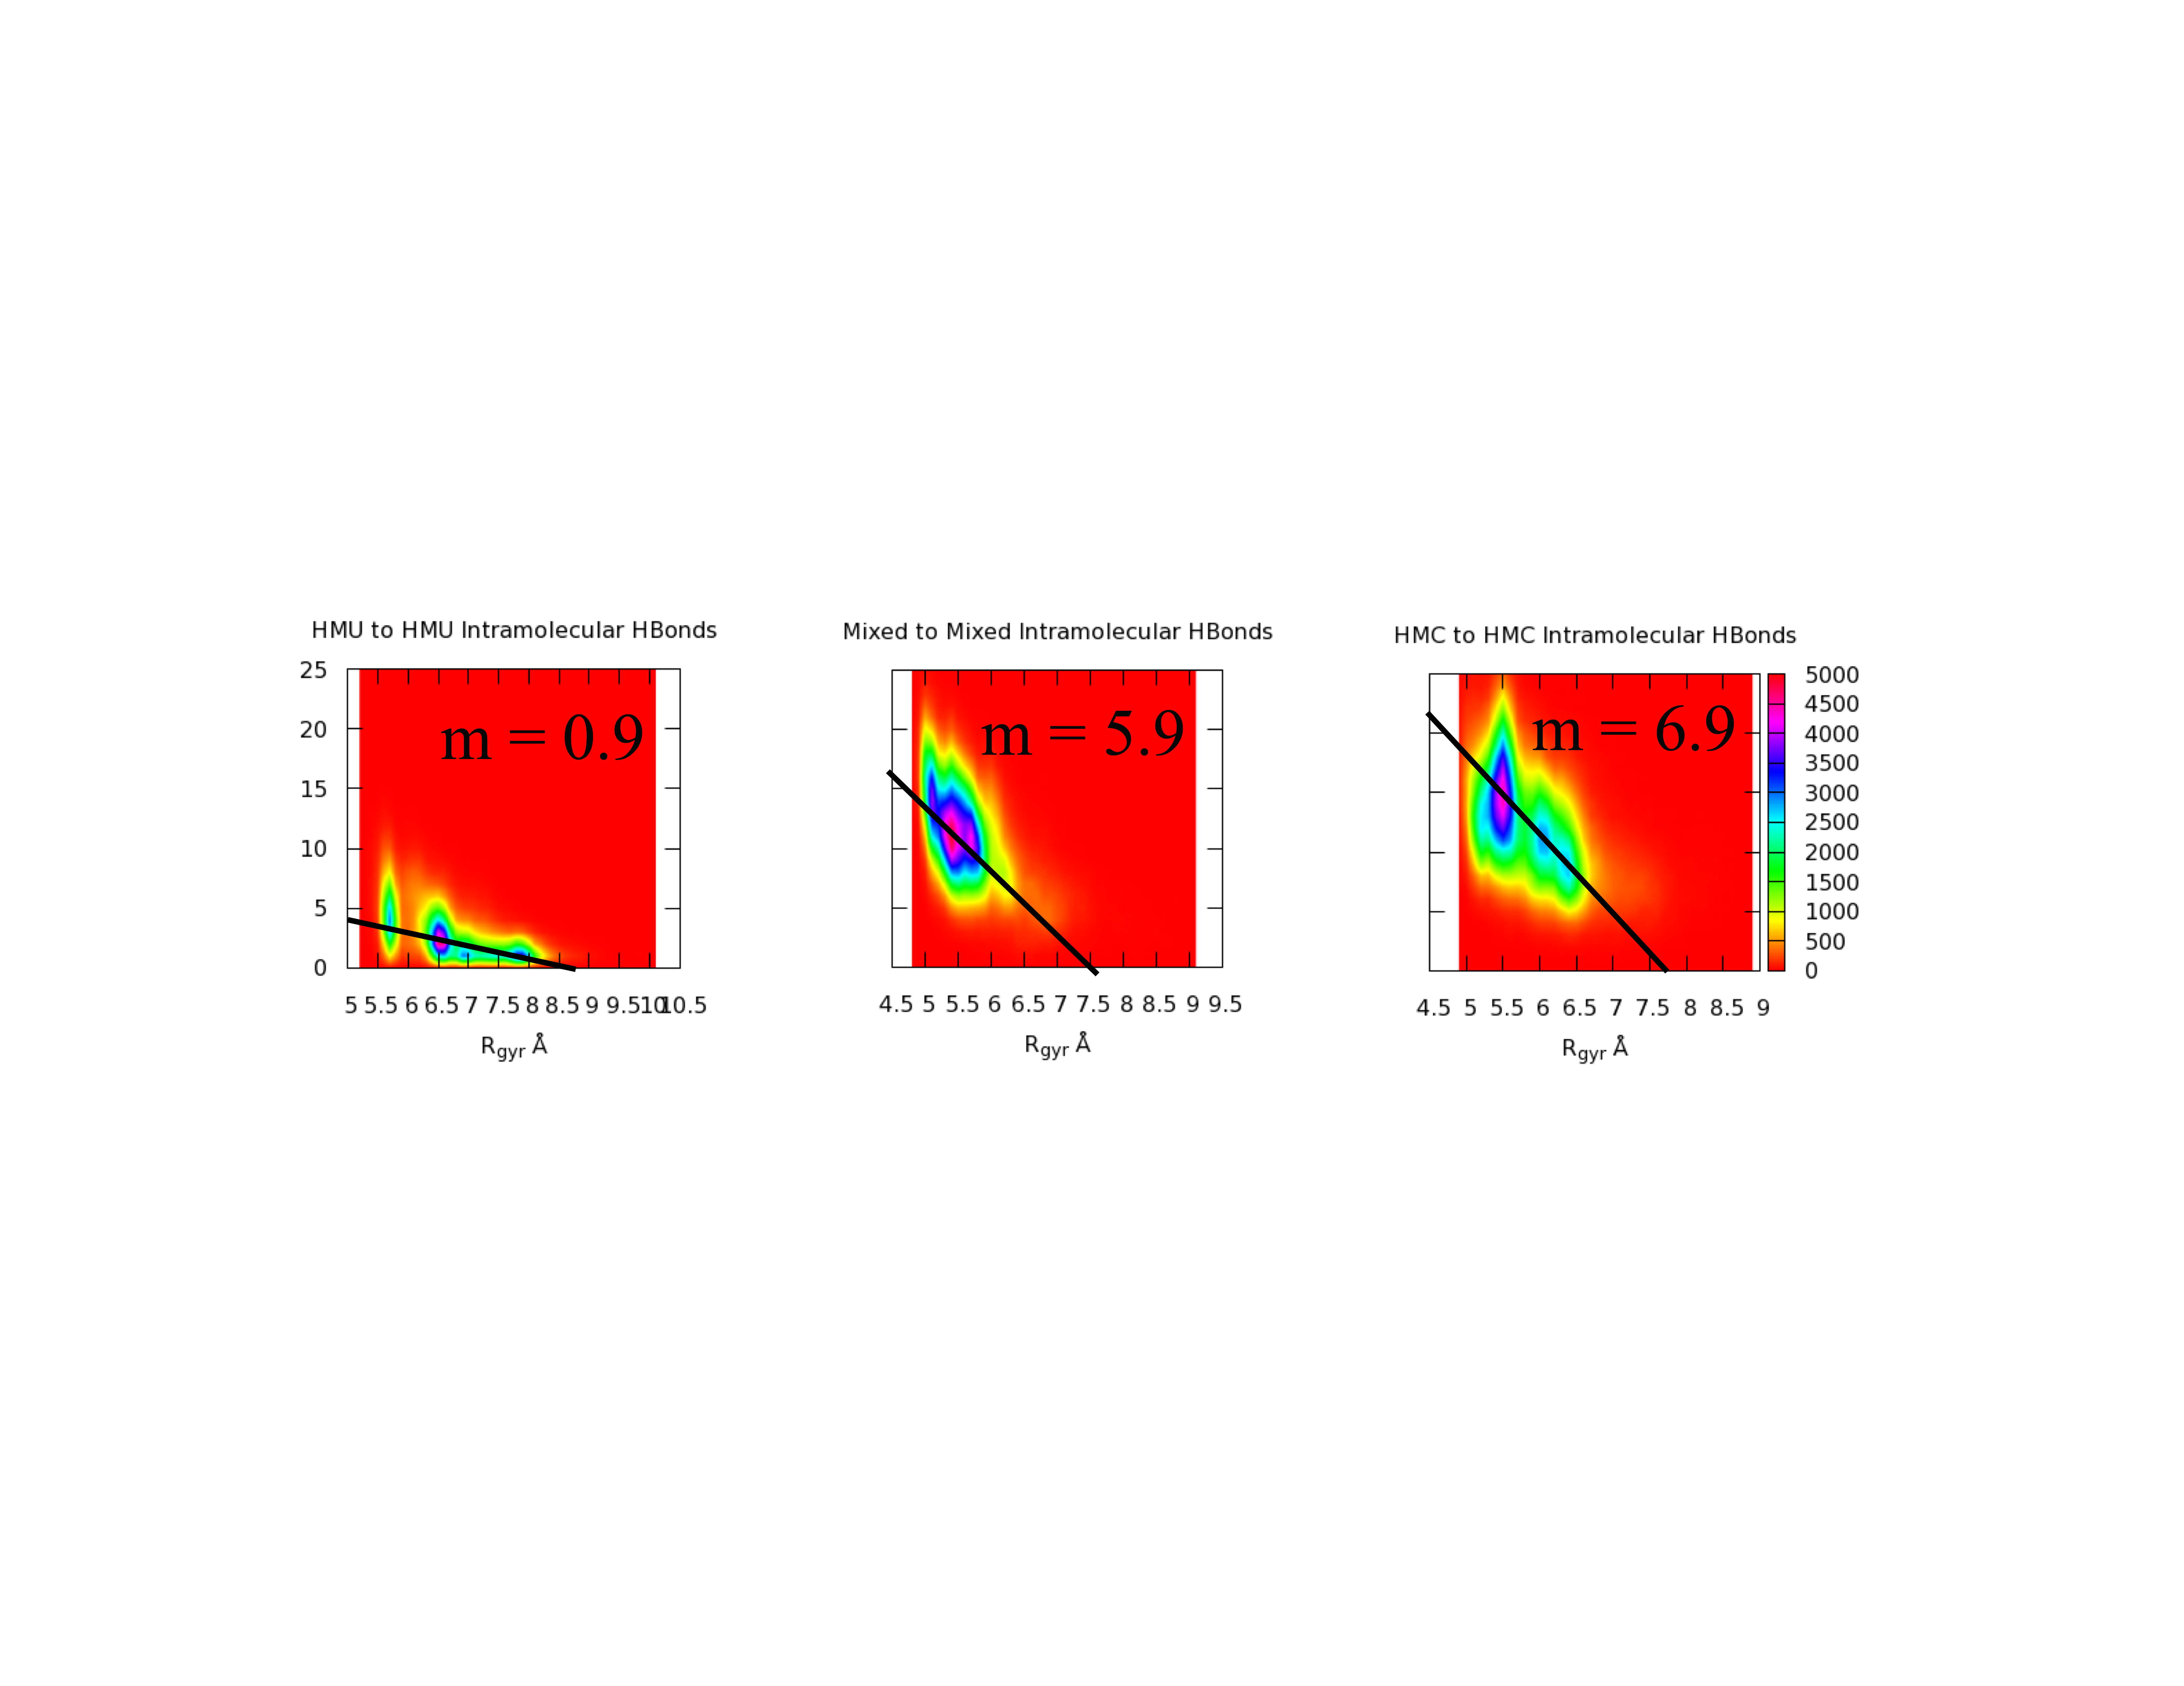
Results
Increasing % Cytosine in Oligomer
Notes:
Talking points:
1. As the % cytosine in the oligomer increases the positive association between intramolecular hydrogen bonds and increased compactness increases. This is similar to secondary structure in DNA because G-C hydrogen bonds stabilize DNA secondary structure.

Slide 10
Key Findings of this Analysis
We see a distinct association between greater numbers of intramolecular hydrogen bonds and increased compactness
As the % of cytosine subunits in an oligomer increased, the association between hydrogen bonds and increased compactness was stronger
Notes:
Talking Points:
The association between intramolecular hydrogen bonds and increased compactness directly correlates with how meaningful biological structure is formed in modern biomolecules.
The association between % cytosine present and a stronger signal between intramolecular hydrogen bonds and increased compactness directly correlates with DNA secondary structure stability.

Slide 11
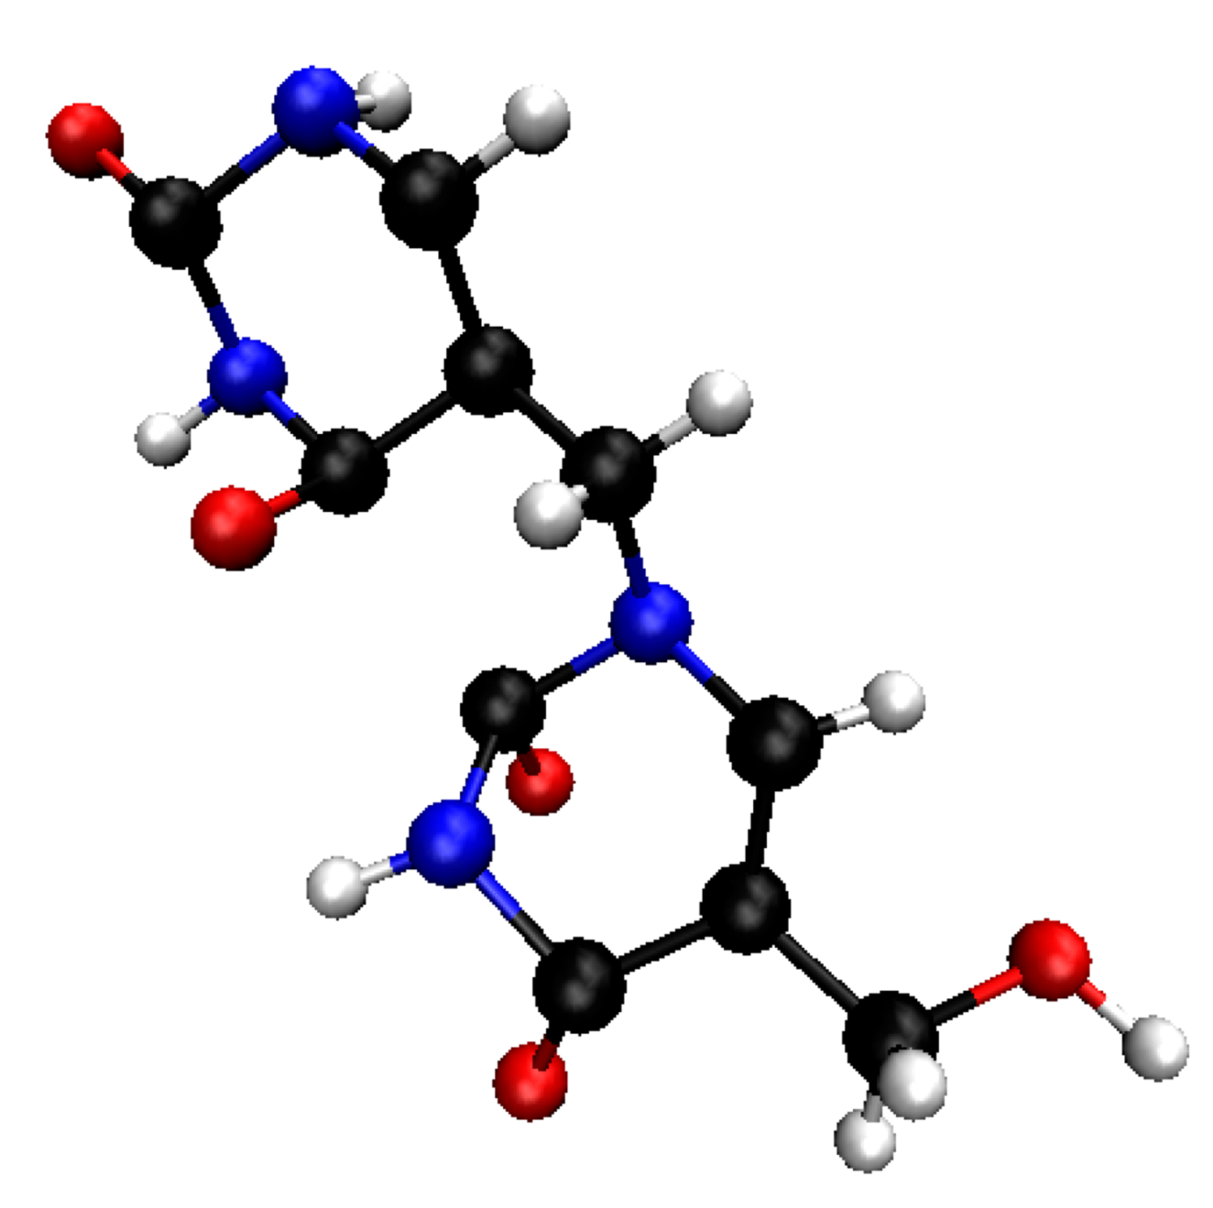
Future Investigations
Stable secondary structure in DNA, RNA, and proteins have consistent backbone dihedral angles.
Evaluate molecular dynamics in non-pure water simulations.
Use steered methods to evaluate base-pairing characteristics between these molecules and other genetic molecules
Dihedral Angle
Notes:
Talking points:
Backbone dihedral angle can be compared to number of Hydrogen Bonds, Radius of Gyration, and dihedral angles of known protein and nucleic acid secondary structures.
We have only evaluated these oligomers in pure water systems, early Earth’s oceans would have contained many constituents, these constituents can influence secondary structure.
We can use steered molecular dynamics to evaluate the potential for base pairing interactions between oligomer strands.

Slide 12

Funding
NAU Hooper Undergraduate Research Award
NAU Undergraduate Travel Grant
NASA Space Grant & Arizona Space Grant Consortium

Slide 13

Acknowledgments
Boise State University Team
  Dr. Michael Callahan
  Dr. Karen Smith
NAU SESES, Department of Geology
  Dr. David Elliott, Ph.D in Paleontology
NAU Department of Chemistry & Biochemistry
  Dr. Gerrick Lindberg
NAU Department of Physics & Astronomy
  Dr. Nadine Barlow
  Kathleen Stigmon
NAU The Lindberg Research Group
  Alex Heyert, Porter Marsh, Shy Dustrud, and Lauren Younger

Slide 14
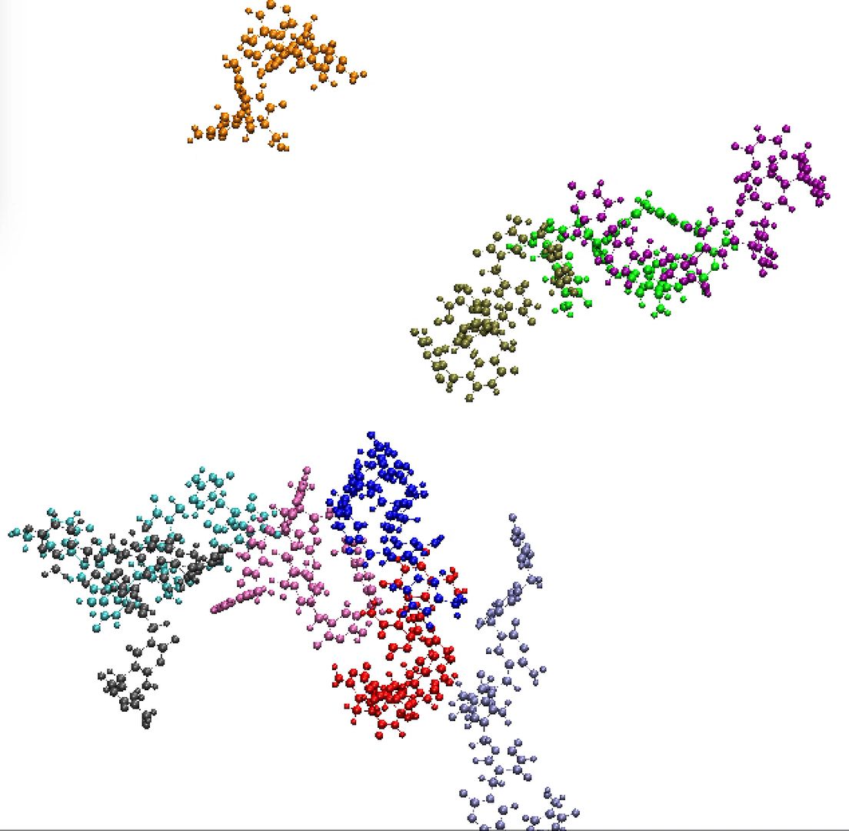
Questions?

